Slide 1
C# ASP.NET MVC
Custom Error Pages

Slide 2
Custom Error Pages
Why Use Custom Error Pages?
Standard IIS error pages may be too verbose
Verbose error messages can give malicious users too much information about your application (ie server, software versions, library versions)
Include specific details to user
Better UX, include navigation menus to get the user back to what they were working on

Slide 3

Custom Error Pages
Web Config Changes
<customError> tag needs to be added
Attribute mode needs to be set to on
<error> child nodes added for each http status code
Attribute redirect specifies the url path to execute

Slide 4
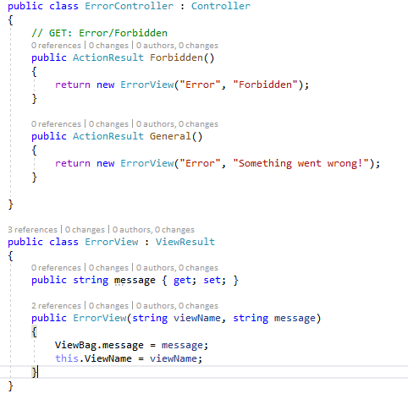
Custom Error Pages
Controller
Create actions for specific errors
Return ViewResult
In example, a class ErrorView extends ViewResult to allow for more customization

Slide 5
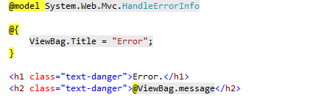
Custom Error Pages
View
Easy to maintain a single Error.cshtml
_Layout can be removed by override Layout and setting it to null or an empty string
Layout = null

